Slide 1

ILRI’s clinical animal research facilities and contract research
Anna Lacasta, PhD
GARA gap analysis
7th- 9th February 2023
ILRI Campus farm facilities
50 hectares

Slide 2
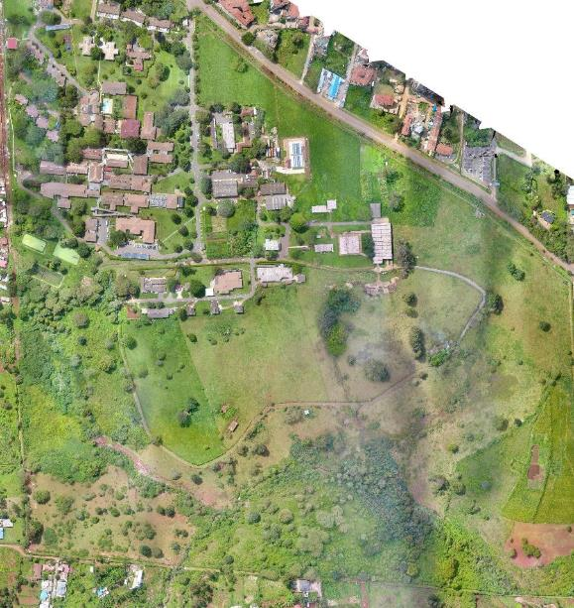
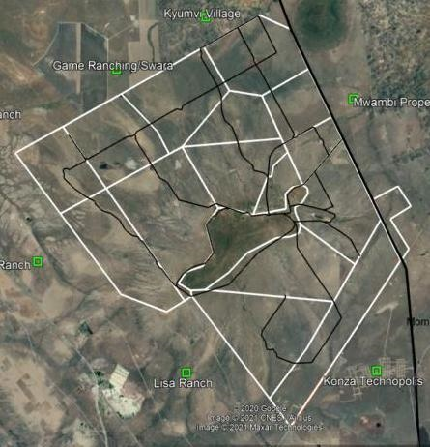
ILRI Farm Kapiti Research Station

Slide 3
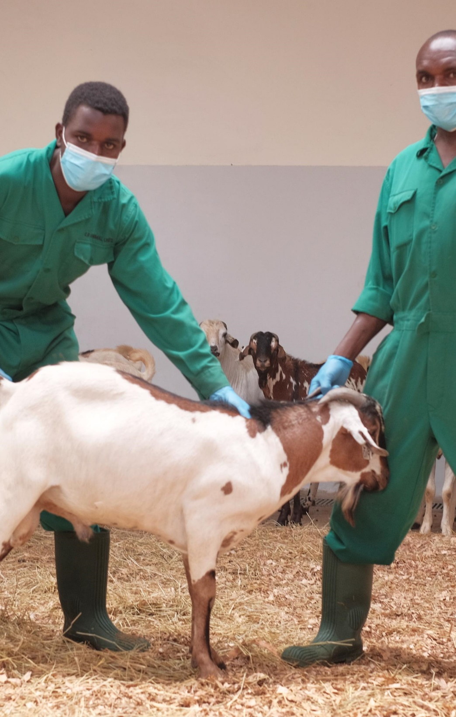
Mission
To provide services to clients (internal and external) for the implementation of clinical animal trials following VICH GCP standards
Main partners:
ILRI’s Vaccine Unit, Tick Unit, Mazingira Center
TAHSSL
ClinGlobal

Slide 4
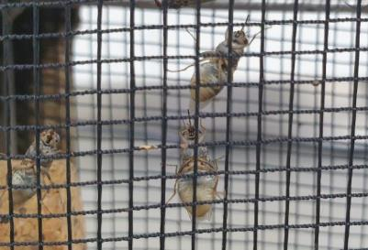
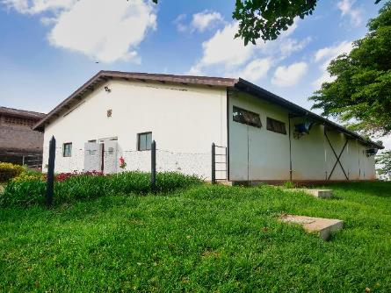
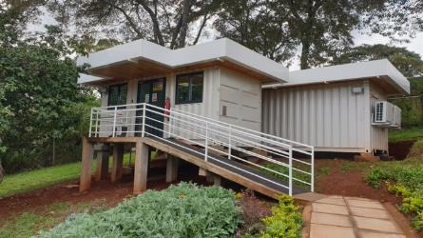
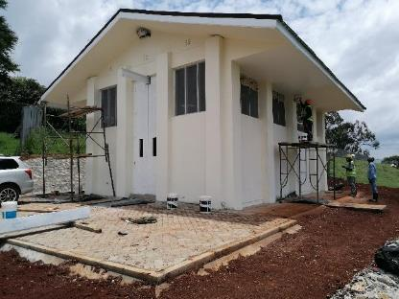
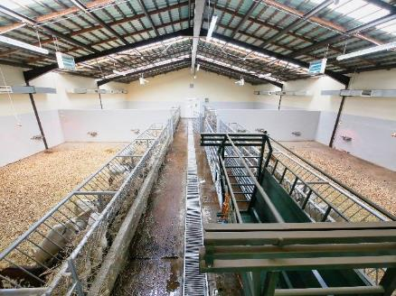
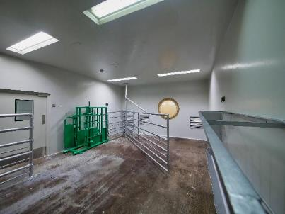
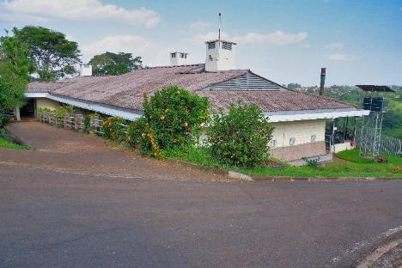
Facilities
~700 adults
~200 pupae
~700 adults
~200 pupae

Slide 5
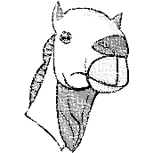
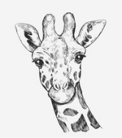
Animal housing and capacity ILRI & Kapiti
All animal spaces and caging compliant with EU guidelines and requirements
ABSL2+ barrier facilities
ABSL1 barrier facilities
Conventional facilities
Kapiti Research Station &
Wildlife Conservancy
42
115
175
3,500
1,600
190
295
495
650
40
50
105
240
365
35
+++
+++
+++
+++

Slide 6

Study capabilities
VICH GCP compliant facility
SANAS accreditation
Services | Bovine | Ovine | Caprine | Camelid | Porcine | Poultry | SAM | In vitro
Development of challenge models | x | x | x | x | x | x | x
Vaccine Efficacy | x | x | x | x | x | x | x
Immunogenicity | x | x | x | x | x | x | x
Local tolerance | x | x | x | x | x | x | x
Pharmacokinetics | x | x | x | x | x | x | x
Residues | x | x | x | x | x | x
Parasitology | x | x | x | x | x | x
Clinical field studies | x | x | x | x | x | x
Feeding trial | x | x | x | x | x | x
Enteric methane emissions | x | x | x | x

Slide 7
ABSL-2 capacity

Slide 8
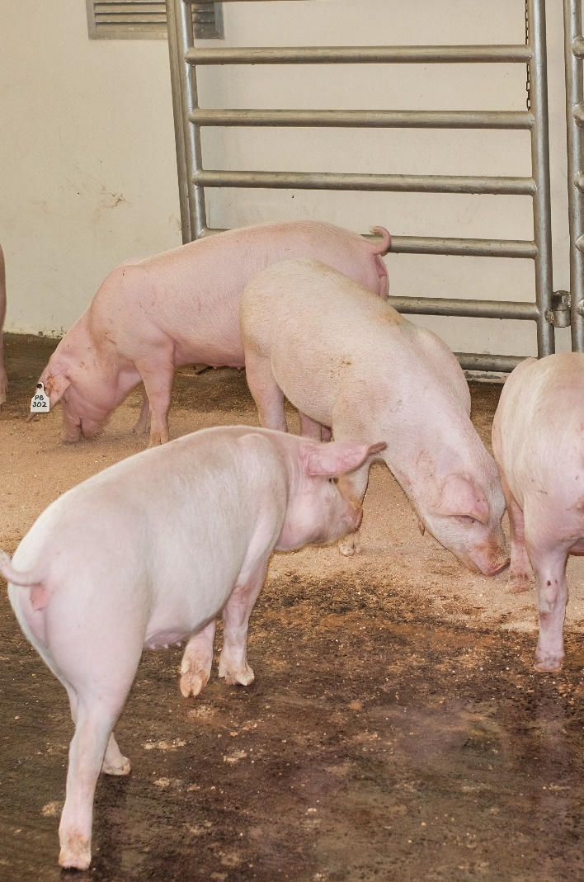
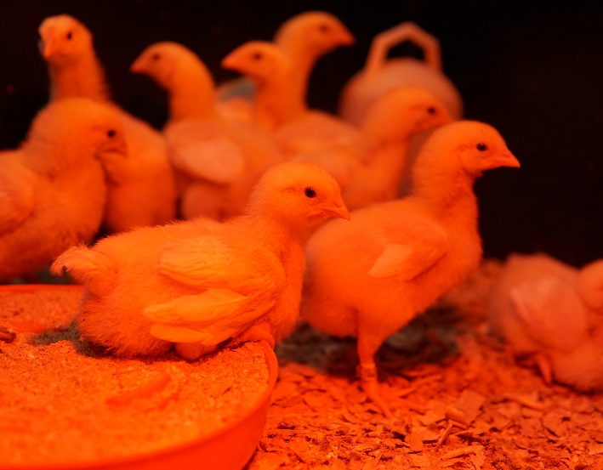
Challenge models, vaccine efficacy, immunogenicity
Pathogens/Diseases:
ASFV, CCPP, CBPP, NSDV, BRSV, T.parva (ECF), PPRV, RVFV, Salmonella sp., Tick vaccine (BM86)
Planned: Trypanosoma sp.
Partners/Sponsors:
ILRI’s Vaccine Group, TAHSSL, ClinGlobal, Pirbright, CIRAD, Oxford / KEMRI / Wellcome Trust, Zoetis, USDA, IDRC

Slide 9
Pharmacokinetics
Residues
Testing products for tsetse fly control
Partners:
ClinGlobal, Elanco, BMGF
Testing Aflatoxin binders in dairy cows and poultry (broilers and layers)
Partners: Ghent University
Feeding trial/enteric methane
Clinical field studies
Impact of feeding regimes & infections on GHG comparing indigenous vs exotic sheep
Partners:
Mazingira, Melbourne University
Non inferiority study on ChAdOx RVF vaccine;
Partners: KEMRI/Wellcome Trust, Oxford University, Jenner

Slide 10
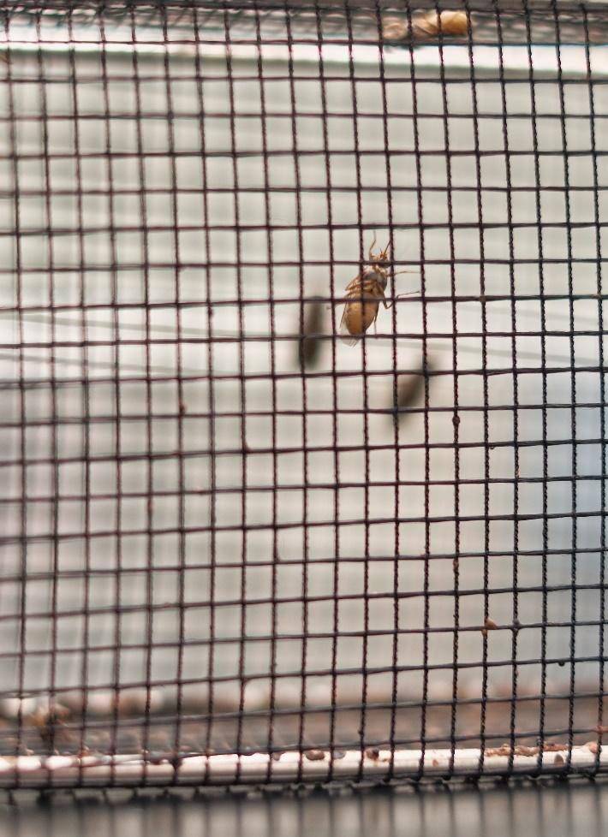
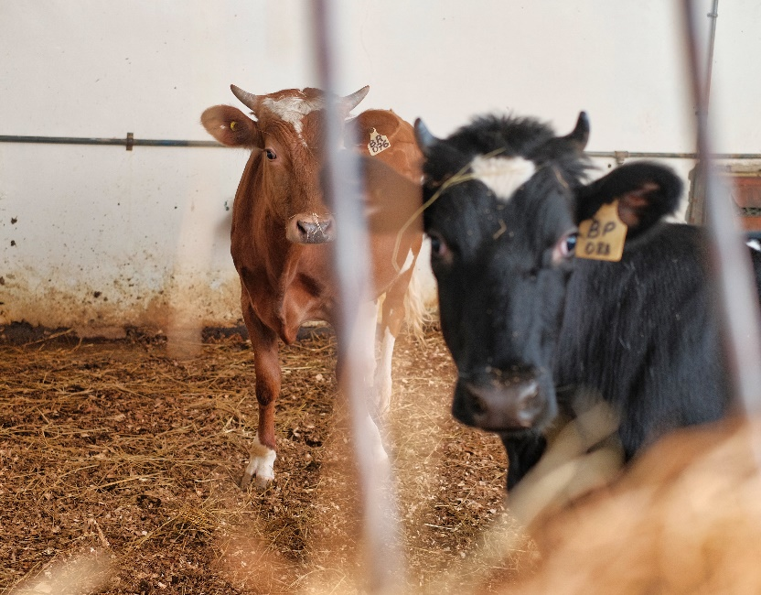
Parasitology
Research on ticks and tick born diseases
Tsetse (Glossina m.m.) trial
T. parva (ECF)
Partners:
ILRI’s Vaccine and Tick Unit, ClinGlobal, Elanco, BMGF, Zoetis, TAHSSL

Slide 11
Anna Lacasta - Senior Scientist Vaccines Group a.lacasta@cgiar.org
Ilona Gluecks – Farm and Kapiti Manager i.gluecks@cgiar.org
Nimmo Gicheru – Research Operations Manager n.gicheru@cgiar.org

Slide 12
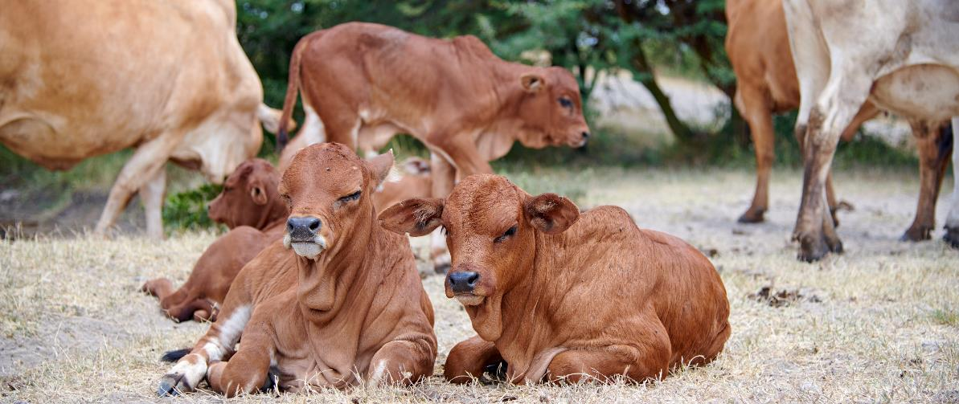
THANK YOU

